Slide 1
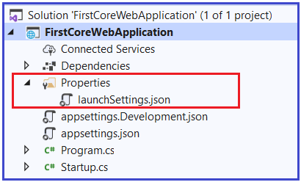
launchSettings.json
As you can see from the above image, the ASP.NET Core Project has a file called launchSettings.json within the Properties folder. So, let us discuss the need and importance of this launchSettings.json file in the ASP.NET Core application.
Understanding LaunchSettings.json file in ASP.NET Core
The settings that are present within this file are going to be used when we run the .NET core application either from Visual Studio or by using .NET Core CLI.
The most important point that you need to keep in mind is this launchSettings.json file is only used within the local development machine. That means this file is not required when we publishing our asp.net core application to the production server.
If you have certain settings and you want your application to use such settings when you publish and deploy your asp.net core application to the production server, then you need to store such settings in the appsettings.json file. Generally, in the ASP.NET Core application, the configuration settings are going to be stored in the appsettings.json file

Slide 2
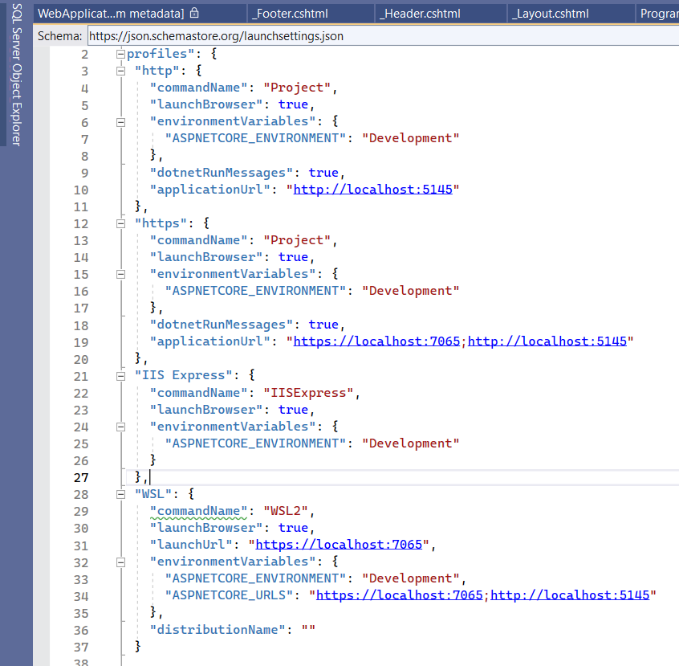
In the above launchSettings.json file, within the profiles, we have two sections i.e. IIS Express and FirstCoreWebApplication as shown in the below image.
The point that you need to remember is when you run the application from Visual Studio either by pressing CTRL + F5 or just F5 then by default the profile with “commandName”: “IISExpress” is going to be used.
On the other hand, if you run the ASP.NET Core application using .NET Core CLI (i.e. dotnet run command), then the profile with the “commandName”: “Project” is going to be used.
Project Name
IISExpress settings

Slide 3
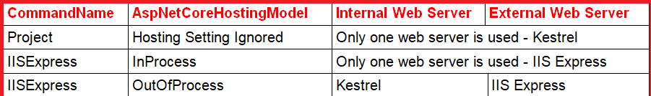
The value of the commandName property of the launchSettings.json file can be any one of the following.
IISExpress
IIS
Project
The CommandName property value of the launchSettings.json file along with the AspNetCoreHostingModel element value from the application’s project file will determine the internal and external web server (reverse proxy server) that are going to use and handle the incoming HTTP Requests. For better understanding, please have a look at the below table.

